Slide 1
WHAT’S THE BROWSER?
The browser main functionality is to present the web resource you choose, by requesting it from the server and displaying it on the browser window. The resource format is usually HTML but also PDF, image and more.

Slide 2
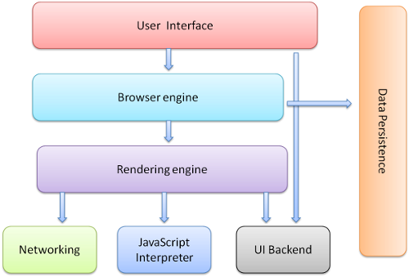
Browser components

Slide 3
USER INTERFACE
The space where interaction between users and the browser. Most of the browsers have common inputs for user interface:
•Address bar.
• Next and back buttons.
•Buttons for home, refresh and stop •Bookmark web pages
•…etc.

Slide 4
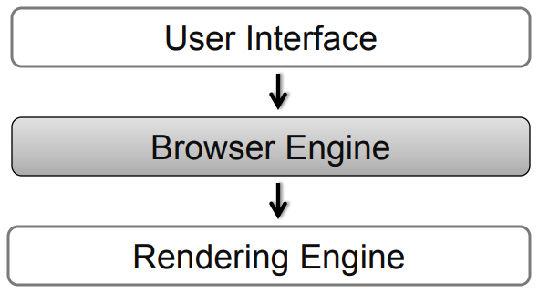
BROWSER ENGINE
The bridge between User Interface & Rendering Engine

Slide 5
BROWSER ENGINE
Browser Engine provides methods to begin the loading of URL and other high-level browsing actions. –
Reload, Back, Forward actions
Error messages
Loading progress

Slide 6
RENDERING ENGINE
Rendering Engine interprets (render) the HTML, XML, JavaScript and generates the layout that is displayed in the User Interface. Key component of this phase is HTML, CSS parse.
This is a reasons why the browser display a website so difference.

Slide 7
NETWORKING
Access and transfer data on the internet (calls HTTP, HTTPS, FTP).
The Networking components handles all aspects of internet communication or security.

Slide 8
JAVASCRIPT INTERPRETER
Component parse & executes the JavaScript that is embedded in the website.
Results of the execution a passed to the Rendering Engines for display

Slide 9
DISPLAY BACKEND
Display common UI components.
Drawing basic widgets like combo boxes, windows.

Slide 10
DATA PERSISTENCE
Storing the data on the client side. –
-Cookies.
- Cache.

Slide 11
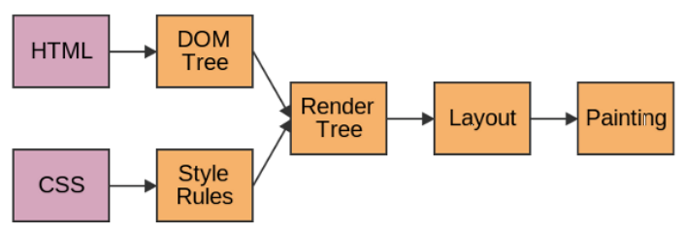
THE BASIC FLOW OF RENDERING ENGINE
1. Parsing HTML to construct the DOM
2. Render tree construction
3. Layout of the render tree
4. Paint the render tree

Slide 12
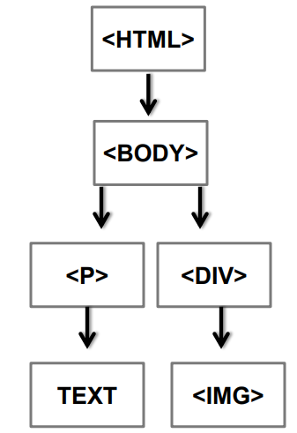
HTML PARSER DOINGS
Parses input HTML tag
Fixes developer mistakes
Request to load resource
Constructs DOM tree

Slide 13
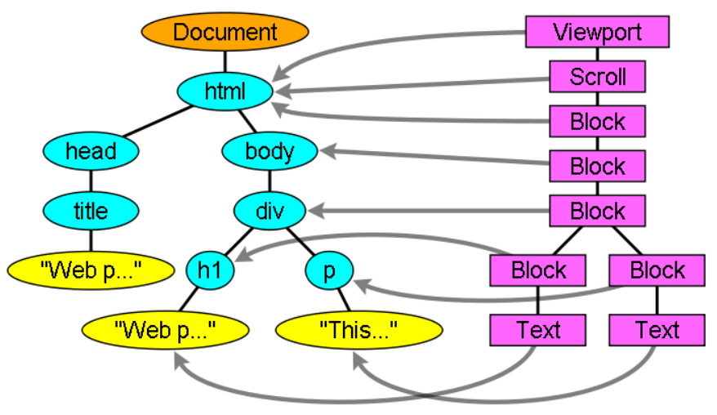
RENDER TREE CONSTRUCTION
Tree of visual elements in display order.
Style information, computed metrics

Slide 14
LAYOUT THE RENDER TREE
What is Layout process?
• Calculation of geometry and position
• Flow based model (left-to-right, top- to bottom)
• Coordinate system relative to top left coordinates

Slide 15
PAINTING
Go through the tree from the root Global and Incremental paint Painting order (CSS2): – background colour
background image
Border
… Changes style will cause restyle and repaint of the element. Changes of position will cause relayout and repaint.

